Slide 1
Get me out of here: Determining optimal policies
Seminar: Cyber Physical systems
Advisor: Christian Pek

Slide 2
Outline
Background and Problem Statement
Fundamentals of Dynamic Programming
Solving the Dynamic Programming equations
Related work and use cases in robot motion planning

Slide 3




Background and Problem Statement

Slide 4

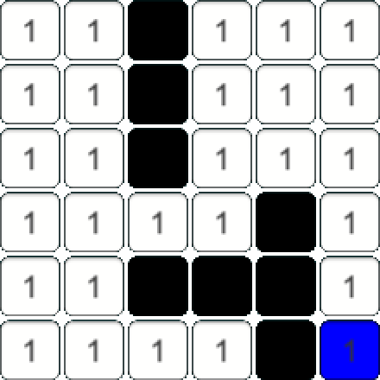

Background
The game labyrinth
Gridmap $M=ℕ^{n × m }$
Walls $M\left(i,j\right)=∞$
Set of exits $X_{goals}$

Slide 5
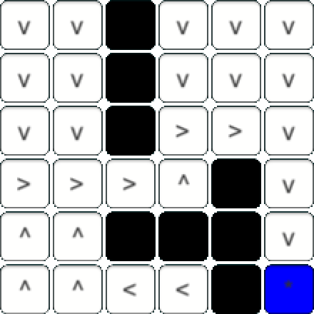


Problem Statement
Determine optimal policies
Function assigning the best possible action to every position in the maze
$P=N^{n×m}→A$
$$→$$

Slide 6
Fundamentals of Dynamic Programming

Slide 7

What is Dynamic Programming
Method used in mathematical optimization
Transforms complex problems into sequences of simpler subproblems
General framework for a broad variety of problems
Base concept: Sequential decision making problem
Tupel $\left\langle X,U,f,c,v,x_{init}\right\rangle$

Slide 8
The principle of optimality
A policy is a sequence of decisions
An optimal policy is a sequence of decisions that has the best outcome w.r.t. a predefined criterion
Principle of Optimality
An optimal policy has the property, that whatever the initial state and initial decisions are, the remaining decisions must constitute an optimal policy with regard to the state resulting from the first decisions.

Slide 9

Mathematical formulation
$p=\left(p_{1},p_{2}, …,p_{M}\right)∈X$
$U=\left\{T_{k}\right\}; p∈X⇒T_{K}\left(p\right)∈X, ∀k$
$P=\left(T_{1}, T_{2}, …, T_{N}\right)$
$p_{1}=T_{1}\left(p\right)$
$p_{2}=T_{2}\left(p_{1}\right)$
$⋮$
$p_{N}=T_{N}(p_{N−1})$
$h_{N}\left(p\right)=\max_{p}{R(p_{N})}$
$h_{N}\left(p\right)=\max_{k}{h_{N−1}(T_{K}\left(p\right))}, N=2,3,…$

Slide 10
Characteristics of problems solvable by Dynamic Programming
Fundamentals of dynamic programming

Slide 11
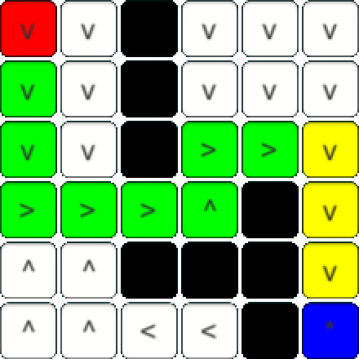
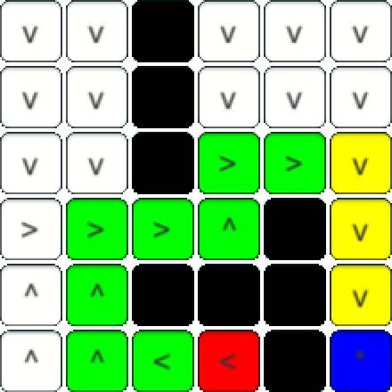
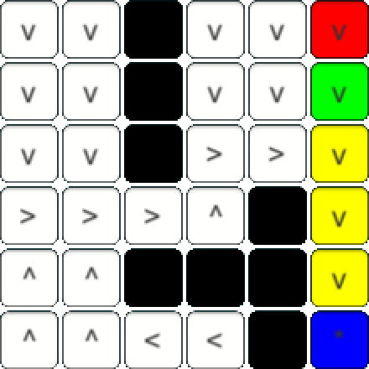
Overlapping Subproblems

Slide 12
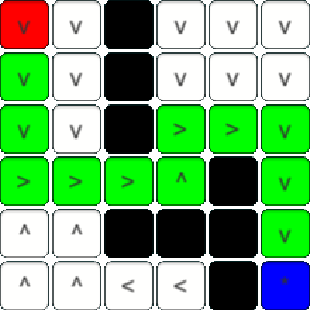
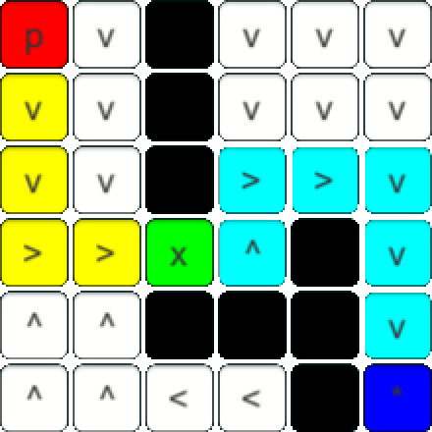
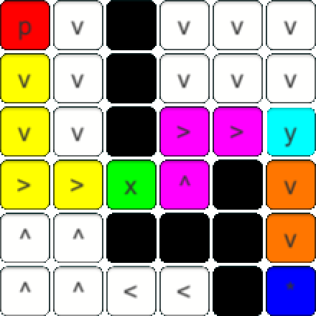
Optimal Substructure

Slide 13
How to apply Dynamic Programming in Computer Science
Fundamentals of dynamic programming

Slide 14

Memoization
Result of overlapping subproblems
Break down into small set of subproblems
Store results in a table
Use cached results if problem reoccuring
Computation time $⟷$ Memory usage

Slide 15

Bellman equation
Objective function defining desired outcome
State of system is tracked
Controls affect current state → Transformations
Value function giving best possible value of objective function
Backwards induction as direct outcome of Bellman equation
$V\left(x_{0}\right)=\max_{a_{0}}{ \{F\left(x_{0},a_{0}\right)+V\left(x_{1}\right)\}}$
$V\left(x_{0}\right)=\max_{a∈Γ(x)}{ \{F\left(x,a\right)+V(T(x,a))\}}$

Slide 16
Solving the Dynamic Programming equations

Slide 17

Finding the value function
Gridmap $M=ℕ^{n × m }$
Walls $M\left(i,j\right)=∞$
Optimal policies $P=ℕ^{n × m}→A$
Goal is to find value function $v\left(i,j\right)∈ℕ$
Cost function $c\left(i,j\right)=M(i,j)$
Trivial cases $v\left(i,j\right)=\left\{\begin{aligned}∞, if i<1 or i>n or j<1 or j>m \\ 0, if \left(i,j\right)∈X_{goal}\end{aligned}\right.$

Slide 18

Finding the value function
Backwards iteration: $(N, N−1,…,0)$
Store results in memoization table $V^{n×m}$
$v\left(i−1,j\right)=v\left(i,j\right)+c\left(i,j\right) if v\left(i−1,j\right)<V(i,j)$
$v\left(i+1,j\right)=v\left(i,j\right)+c\left(i,j\right) if v\left(i−1,j\right)<V(i,j)$
$v\left(i,j−1\right)=v\left(i,j\right)+c\left(i,j\right) if v\left(i−1,j\right)<V(i,j)$
$v\left(i,j+1\right)=v\left(i,j\right)+c\left(i,j\right) if v\left(i−1,j\right)<V(i,j)$

Slide 19



Finding the value function
Stage $N$
$v\left(3,4\right)=0$
Stage $N−1$
$v\left(3,3\right)=v\left(3,4\right)+c\left(3,4\right)=0+1=1$
$v\left(3,3\right)=v\left(3,4\right)+c\left(3,4\right)=0+1=1$
$v\left(3,3\right)=v\left(3,4\right)+c\left(3,4\right)=0+1=1$
$v\left(3,3\right)=v\left(3,4\right)+c\left(3,4\right)=0+1=1$
Stage $N−2$ (exemplary)
$v\left(2,3\right)=v\left(2,4\right)+c\left(2,4\right)=1+1=2$
$v\left(3,4\right)=v\left(2,4\right)+c\left(2,4\right)=1+1=2$
$v\left(2,5\right)=v\left(2,4\right)+c\left(2,4\right)=1+1=2$
$v(1,4)=v\left(2,4\right)+c\left(2,4\right)=1+1=2$

Slide 20
Solving the Dynamic Programming equations
Final value function solving the Bellman equation

Slide 21
Related work and use cases in robot motion planning

Slide 22
Related work and use cases in robot motion planning

Slide 23
Related work and use cases in robot motion planning

